Slide 1
JAVA SEMINAR
1. Write a program to illustrates connecting to the Authors database, querying the database and processing the result.

Slide 2
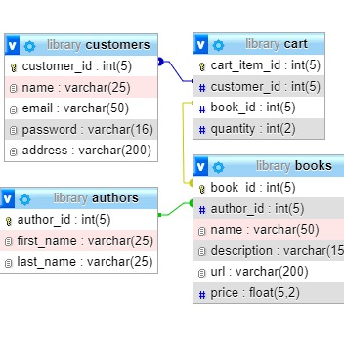
DATABASES
Databases for all programs

Slide 3
STEPS:
Create get connection object using the help of db connection helper class
Get choice input from user, display, insert, delete record.
Get appropriate input if needed according to users choice first name and last name for insert choice id for delete record choice.

Slide 4
STEPS:
Perform action chosen by user,
insert - insert record by input given by user.
display - run select query and display records
delete - delete the record selected by user to be deleted

Slide 5
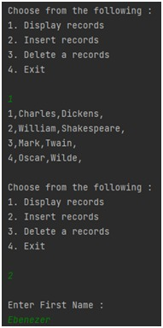
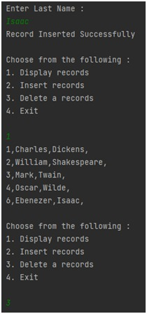
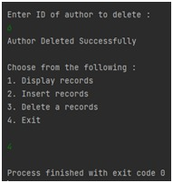
OUTPUT:

